Slide 1
Computer Applications

Slide 2
File formats
File formats are often ignored by users
Applications automatically save files in the application’s format
All formats are made for a reason, efficiency, effectiveness – saving the information needed to recreate the document as saved
Many formats are commercial, they add to the creating company’s bottom line by keeping customers locked into the company’s software

Slide 3
Windows Registry (New)
When a new application is installed on a machine with Windows OS, it usually adds itself to the Registry
The Registry is a file kept in the Windows file system which records which application is associated with which file extensions (among other things)
This allows you to double-click on an icon representing a document of some kind and Windows knows which application to use to open it
Can be a battle between applications sometimes about which one “gets” an extension
Viruses are also known to store themselves in there to hide from anti-virus software.
Be VERY careful if you edit the Registry!

Slide 4
Digital Rights Management
DRM - added to some formats
Prevents files from being copied or from being played on unauthorized devices
AAC (extension .m4p) has DRM from Apple
Subject of much controversy

Slide 5
Audio player apps
Sound is Analog - to manipulate it with a computer, it must be converted to digital
Microphone takes in analog sound waves and the audio app samples the signal every so often (44,100 samples per second is common)
Each sample is turned into a number using an Analog-to-digital converter
Sound is played back by putting the numbers through a Digital-to-Analog converter and out through a speaker
Most OS’s come with an app for playing music/sound
To edit sound you usually need to find either a shareware or commercial application

Slide 6
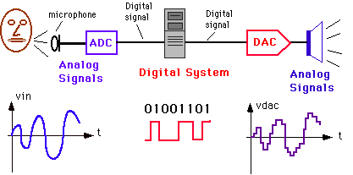
ADC and DAC sound processing

Slide 7
Audio file formats
Most popular format MP3
Compressed by cutting off the “high” and “low” parts of the original recording, under the assumption that most humans can’t hear them – not as good as the quality of a CD
Good enough – small enough for fast downloads, but “lossy”
Most CD rippers create MP3’s

Slide 8
Other audio formats
WAV (Windows audio-visual file) (uncompressed)
AIFF (Audio Interchange File Format) (Apple)
These are popular with professional musicians
Better quality than MP3’s, “lossless”
Not compressed, so large files (10 MB for one minute of stereo audio)
(New) MIDI (Musical Instrument Digital Interface) – a standard for capturing sound from different instruments and storing it – you can buy instruments (guitar, drums, keyboard, etc.) which have a MIDI port. Mostly used by professionals

Slide 9
Video player apps
Video is a file that contains many slightly differing images which are displayed quickly enough that human eye/brain cannot see them as individual. So they look like continuous motion to us. Each image is called a frame and the speed they are displayed at is the frames per second (fps)
Video files are very large. Most formats like mp4 or mov use some form of compression. They do not store every single image fully. They will store certain frames (called key frames) completely, then store only the information about how the other frames differ from the key frames

Slide 10
Video Formats
AVI – oldest, lots of apps can play them, not as good a quality as newer formats
WMV – From Microsoft, not good quality, small size file
MOV – Apple QuickTime – high compression, decent quality
MP4 – newer format, high compression, decent quality, can be played by most browsers

Slide 11
Video Player Apps
QuickTime for Macs
Windows Media Player on Windows
Free VLC
Streaming – playing video directly from the Internet using an app like a browser without storing the data on secondary storage – comes into RAM and is played as quickly as possible

Slide 12
PDF viewer
Portable Document Format
Created by Adobe, released to public in 2008
Readable/viewable by almost any application that creates documents under many different OS’s
Easy to create / edit these days – many apps have option to “Print to PDF”

Slide 13
Text formats
Even with composing email, you are creating text in a format of your choosing
When you write a message in a proprietary format like docx and send it as an attachment, the recipient has to double click the link, which downloads the file, opens Word, lets them read the message, then go back to the email client
Compare the size of a text file to a Word docx file which contains the same words. The difference can be huge! Why? Word stores many hidden ‘control characters’ as well as more information about the file – the author, the font used, large chunks of text that were deleted…

Slide 14
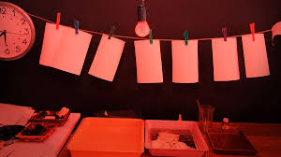
In the old days
Cameras were “analog” – film-based
Photos were expensive to make
You did not make duplicates
Prints had to be treated very carefully, negatives even more so!
Photos took a long time to make, usually by mail

Slide 15
Today
Cameras are digital – recording light frequencies as numbers on a storage medium
Cameras rated as “so many Megapixels” resolution
Photos are cheap, good quality and immediate
Now you can take lots of pictures of the same scene, and discard the bad / poor quality ones
Information overload – too many pictures!

Slide 16
Storing / Organizing Photos
“Metadata”
  You can rate photos with “star ratings”
  Put keywords or tags on them
  Have to keep using the system or it is useless
  If you are using a particular application / site to store your metadata, you are bound to it

Slide 17
Cautions about photos
Don’t put photos on the net (or on a phone) which you do not want seen by EVERYBODY
Don’t expect you can “erase” a photo once it is on the Net or sent to someone else – “bits are forever” – backups always exist somewhere
Be aware that many photos have “hidden information” which can be read pretty easily – GPS coordinates, IP number, type of camera, time and date

Slide 18
Maximize the bits then Filter!
Take lots of pictures – the bits are free
This increases the chances that one will be worth keeping
Try different angles, flash or not flash
Instead of a tag, erase most of the photos and keep only the best
Erase the fuzzy, the out-of-focus, the good-but-duplicates
What you have left makes you look like a great photographer!

Slide 19
Picture formats
Different picture formats are for different purposes
Most common is probably JPG or JPEG – joint photographic experts group
Designed to work with pictures with many different colors and shades of color (over 16 million colors)
JPG compresses information whenever possible
Best for photographic images

Slide 20
GIF and PNG
JPG not good for simple images with clear edges and not too many colors
GIF was created by a company called Compuserve a long time ago for use on their on-line system (even before AOL!) “Graphics Interchange Format”
Good for images with relatively few colors (up to 256 colors)
Designed to be as small as possible
Can have some animation in the file
Can be created by MS Paint or Gif editors

Slide 21
GIF and PNG
Compuserve in its last days began to be possessive of its format – insisting on being paid by anyone else writing software to view or manipulate GIF files
PNG was created in reaction to this action
“Portable Network Graphics” was declared to be free and open to anyone who wanted to use the format
More colors than a GIF but no animation

Slide 22
Lossless vs. Lossy Compression
All photo formats compress the data in the image to make the smallest possible file
JPG uses a “lossy” compression – details of the image can be lost if the user is willing to give them up in exchange for a smaller file
GIF and PNG use “lossless” compression methods – they reproduce the image data exactly – can give a larger file if there are lots of colors in the picture

Slide 23
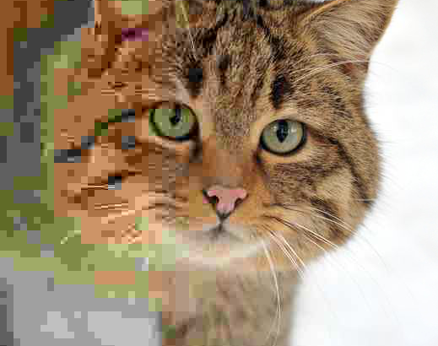
Felis_silvestris_silvestris.jpg: Michael Gäbler
Note how the quality of the jpeg encoding increases as you go from left to right. The left side has “artifacts” because quality is low. Low quality also implies smaller file sizes; higher quality leads to larger file sizes.

Slide 24
Troubleshooting
On any kind of electronics, it pays to know how to “reboot” or “reset” the equipment
Even under normal operations, after a period of time, an app can encounter a bug, even the OS may run into an error.
Turning the power completely OFF (not just “sleep mode”!) will sometimes help reset things back to a “known working state”.
If that does not happen, try some common sense things that you might predict would be wrong – see if they are – is it plugged in? is the power to the house on? Is it turned on? Is it connected to the other device?
If none of that helps, try getting more information “Google it!”

